Slide 1
January 24, 2022 Ara Keshishian
COVID-19 in Bariatric Surgical Practice

Slide 2
Background information
COVID-19
Anesthesia implication
Bariatric Surgery implication
Long Term Follow up Implication

Slide 3
Clinical Information:
Symptoms
Testing
Timing for surgery
https://www.cdc.gov/coronavirus/2019-ncov/hcp/clinical-guidance-management-patients.html

Slide 4
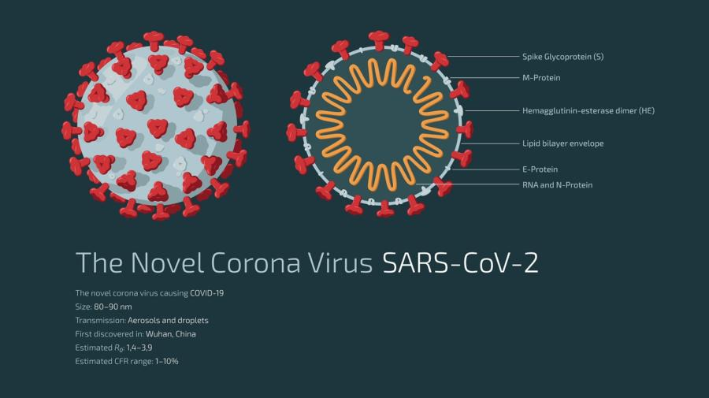
Testing
RNA Shedding for days and weeks (some reported for 3 months)
The tests commonly available for SARS-CoV-2 can detect either:
the RNA − detected by the PCR test
the surrounding proteins − detected by the rapid lateral flow devices
the human body’s response to the virus – detected by antibody tests.

Slide 5
Timing of Surgery
Isolation recommendations change (December 2021)
Timing of the surgery is based on the negative test, and the onset of the symptoms.
The onset is more critical than the test results since it may linger. (December 8, 2020)
https://www.dssurgery.com/elective-surgery-and-anesthesia-for-patients-after-covid-19-infection/?preview_id=10890&preview_nonce=7a2c342a0e&post_format=standard&_thumbnail_id=-1&preview=true

Slide 6
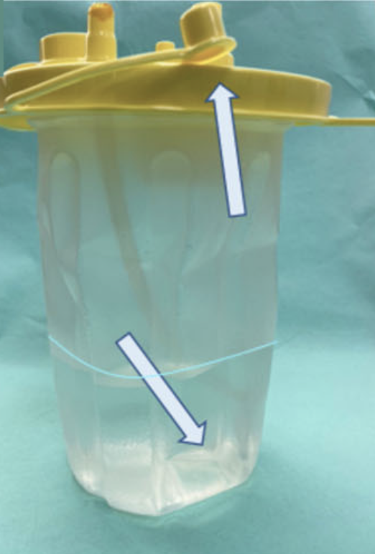
Bariatric Surgery
COVID-19: IFSO LAC Recommendations for the Resumption of Elective Bariatric Surgery
US, Central and South America
Phased introduction
Policy, procedure,
“Water Trap” for all Suction Device
COVID-19 and Obesity: Is Bariatric Surgery Protective? Retrospective Analysis on 2145 Patients Undergone Bariatric-Metabolic Surgery from High Volume Center in Italy (Lombardy)
0.1% ICU admission after COVID, > 2000 patient post op

Slide 7
Bariatric Surgery
Bariatric Surgery and COVID‐19: What We Have Learned from the Pandemic in Iran: a Retrospective Observational Cohort Study
Nutritional Deficiencies
Reduced resolution of Diabetes
Metabolic surgery may protect against admission for COVID-19 in persons with nonalcoholic fatty liver disease
NASH increased odds ration for hospitalization, M > F
Reduced NASH protective with metabolic surgery
Bariatric surgery in patients with previous COVID-19 infection
Relative risk similar to: no history patients if no mechanical ventilation involved

Slide 8
Bariatric Surgery
Weight loss, malnutrition, and cachexia in COVID-19: facts and numbers
40% incidence of malnutrition

Slide 9
References
Tignanelli, C. J., Bramante, C. T., Dutta, N., Tamariz, L., Usher, M. G., & Ikramuddin, S. (2021). Metabolic surgery may protect against admission for COVID-19 in persons with nonalcoholic fatty liver disease. Surgery for Obesity and Related Diseases, 17(10). https://doi.org/10.1016/j.soard.2021.05.029
Nedelcu, M., Marx, L., Lutfi, R. E., Vilallonga, R., Diaconu, V., Aboudi, S., Cirera de Tudela, A., Ferrer, J. V., Ramirez, J., Noel, P., Nedelcu, A., & Carandina, S. (2021). Bariatric surgery in patients with previous COVID-19 infection. Surgery for Obesity and Related Diseases, 17(7), 1244–1248. https://doi.org/10.1016/j.soard.2021.03.029
Anker, M. S., Landmesser, U., von Haehling, S., Butler, J., Coats, A. J. S., & Anker, S. D. (2021). Weight loss, malnutrition, and cachexia in COVID-19: facts and numbers. In Journal of Cachexia, Sarcopenia and Muscle (Vol. 12, Issue 1). https://doi.org/10.1002/jcsm.12674
Anker, M. S., Landmesser, U., von Haehling, S., Butler, J., Coats, A. J. S., & Anker, S. D. (2021). Weight loss, malnutrition, and cachexia in COVID-19: facts and numbers. In Journal of Cachexia, Sarcopenia and Muscle (Vol. 12, Issue 1). https://doi.org/10.1002/jcsm.1267

Slide 10
References
Moradpour, G., Amini, M., Moeinvaziri, N., Hosseini, S. V., Rajabi, S., Clark, C. C. T., Hosseini, B., Vafa, L., & Haghighat, N. (2021). Bariatric Surgery and COVID-19: What We Have Learned from the Pandemic in Iran: a Retrospective Observational Cohort Study. Obesity Surgery. https://doi.org/10.1007/s11695-021-05761-8
Behrens, E., Poggi, L., Aparicio, S., Martínez Duartez, P., Rodríguez, N., Zundel, N., Ramos Cardoso, A., Camacho, D., López-Corvalá, J. A., Vilas-Bôas, M. L., & Laynez, J. (2020). COVID-19: IFSO LAC Recommendations for the Resumption of Elective Bariatric Surgery. In Obesity Surgery (Vol. 30, Issue 11). https://doi.org/10.1007/s11695-020-04910-9
Uccelli, M., Cesana, G. C., de Carli, S. M., Ciccarese, F., Oldani, A., Zanoni, A. A. G., Giorgi, R., Villa, R., Ismail, A., Targa, S., D’Alessio, A., Cesana, G., Mantovani, L., & Olmi, S. (2021). COVID-19 and Obesity: Is Bariatric Surgery Protective? Retrospective Analysis on 2145 Patients Undergone Bariatric-Metabolic Surgery from High Volume Center in Italy (Lombardy). Obesity Surgery, 31(3). https://doi.org/10.1007/s11695-020-05085-z

